Slide 1
CIS 526 – Catbit App
Yuan Su and Grant Unruh

Slide 2
Competitor Apps
Fitbit App
Garmin Connect (Vivo Fit)
My Fitness Pal

Slide 3
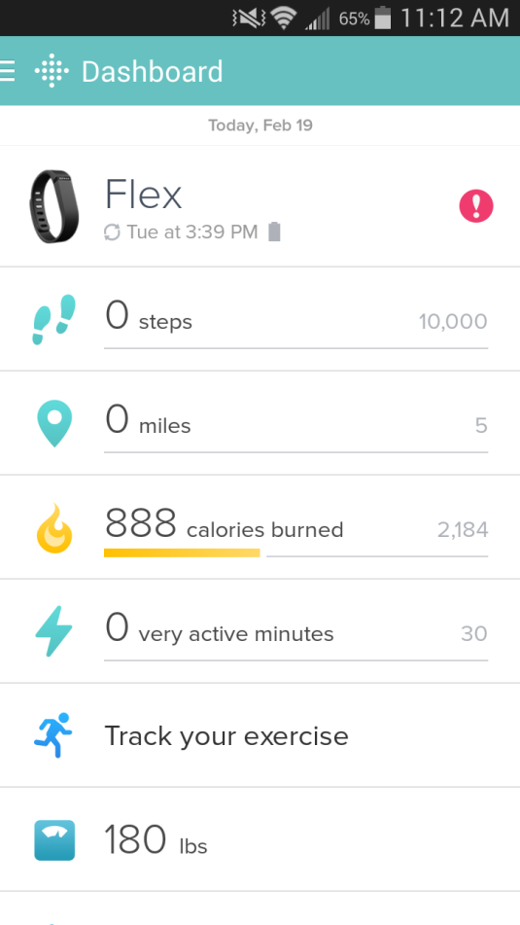
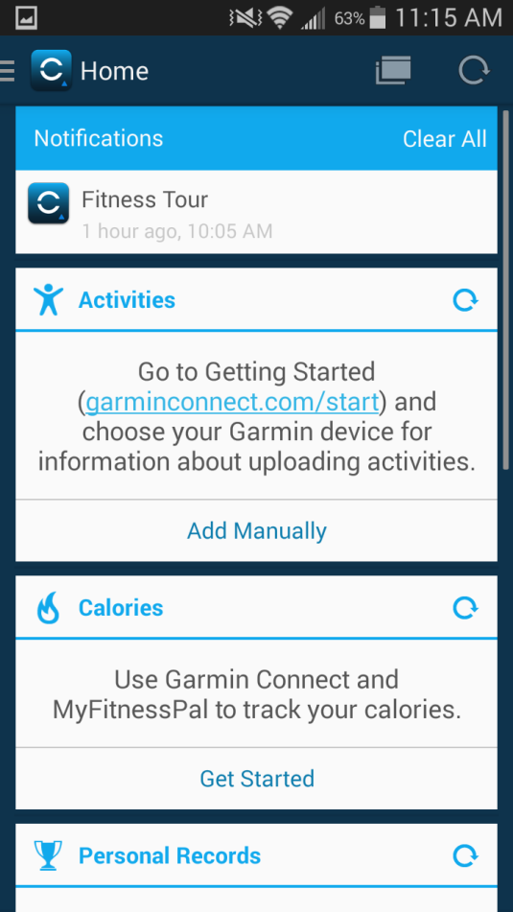
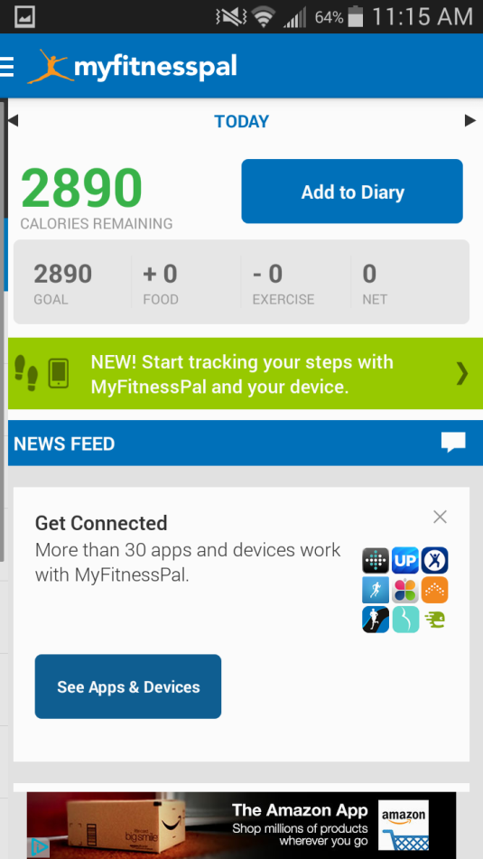
Fitbit, Garmin Connect, myfitnesspal

Slide 4
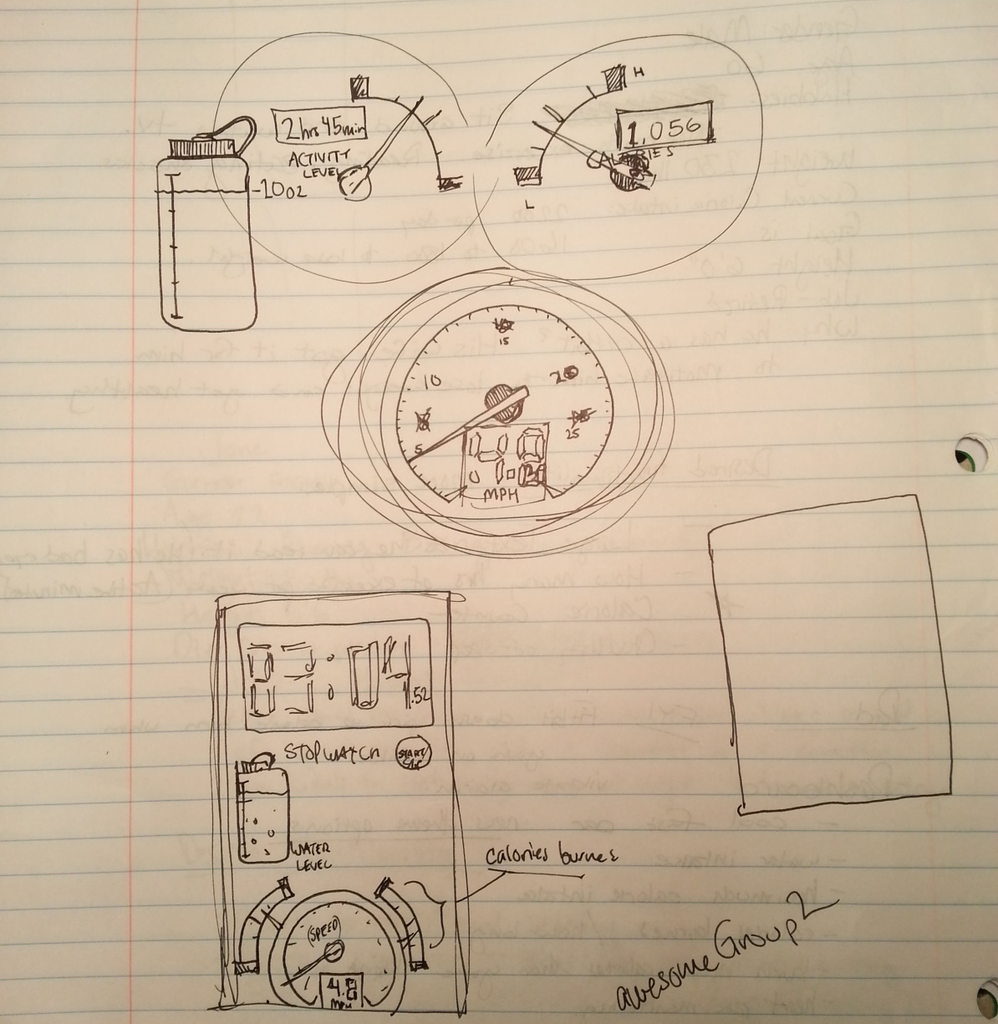
Initial Ideas

Slide 5
User Requirements/Ideas
Make it look like a cool car dashboard
Calories burned vs. consumed
Heart rate monitoring
Display on your TV a trail running video
Keep people from getting bored while they exercise.
Make the sleep quality measurement more accurate

Slide 6
Usability Requirements
Simple and natural dialogue
Speak the user’s language
Minimize memory load
Use constructive error message
Support recall
Make clear exits
Make shortcuts
Give feedback
Prevent errors
Thrive for consistency

Slide 7
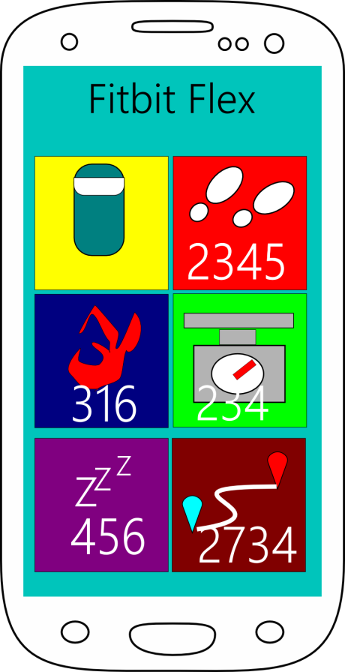
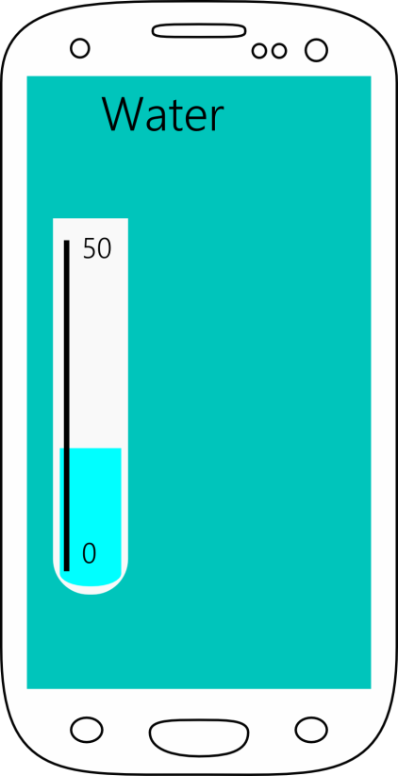
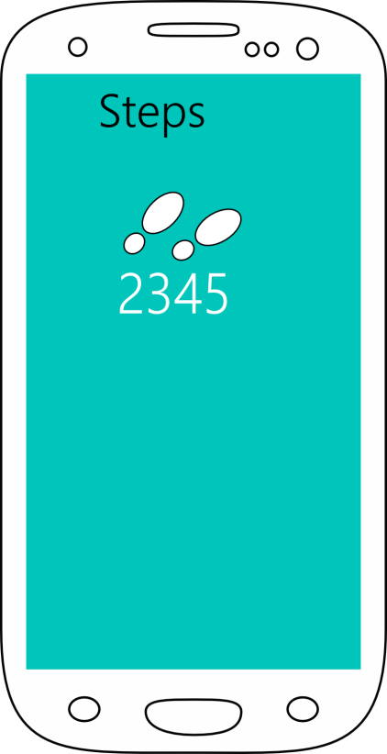
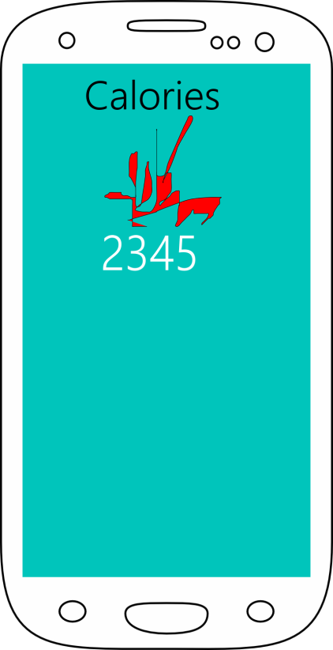
Basic Design Mock-Up

Slide 8

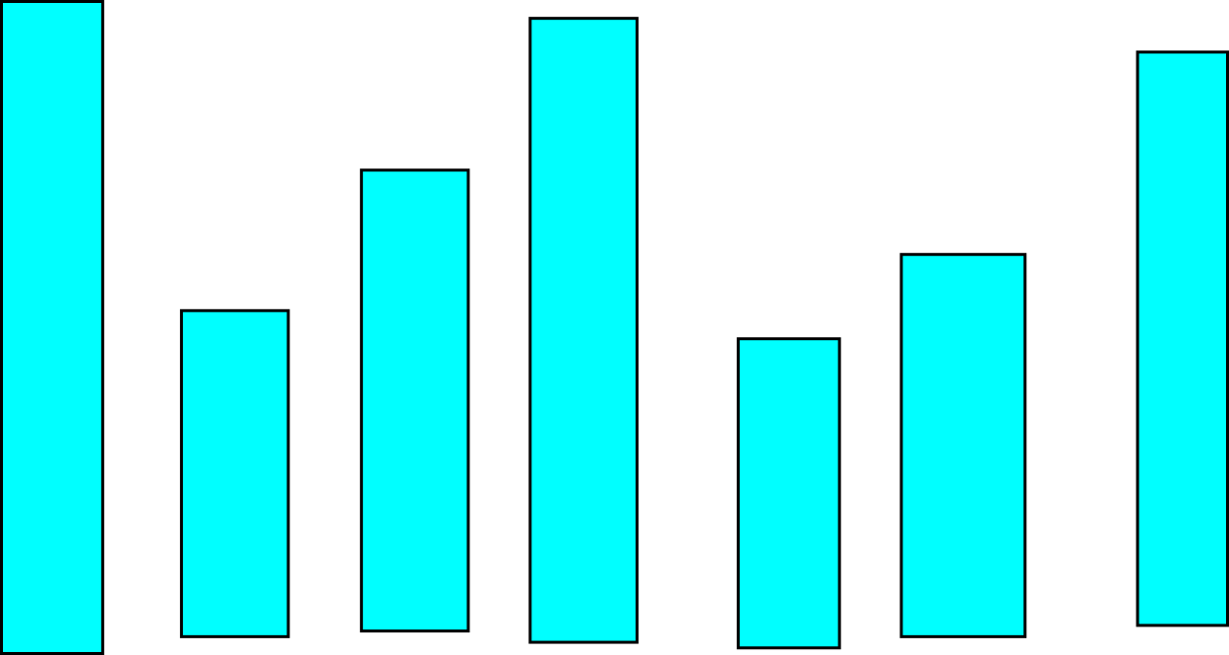
Basic Design Mock-Up
Add Water:

